Slide 1
Chapter 11: Managing Products and Brands

Slide 2
Marketing Strategy Overview – Basic Structure
Analyze the environment and set the strategy
Company
(strengths & weaknesses)
Customers
Segment the market
Target your customers
Position your product
Competition
Product
Price
Promotion
Place
Leveraging real tools to implement strategic objectives

Slide 3
Trivia:
What is the most recognized logo in the world?
What color was Coca-Cola’s brand originally?
What percent of Americans eat McDonalds each day?
How many possible drink combinations are offered at Starbucks?
Notes:
What is the most recognized logo in the world? Coca-Cola
Coca-Cola spends more money on advertising than Microsoft and Apple combined
Coca-Cola advertising budget (2010): $2.9 billion
What color was Coca-Cola’s brand originally? Green
What percent of Americans ate McDonalds each day? 7%
How many possible drink combinations are offered at Starbucks? Over 87,000

Slide 4
Preview
Product Life Cycle
Diffusion of Innovation
Branding

Slide 5
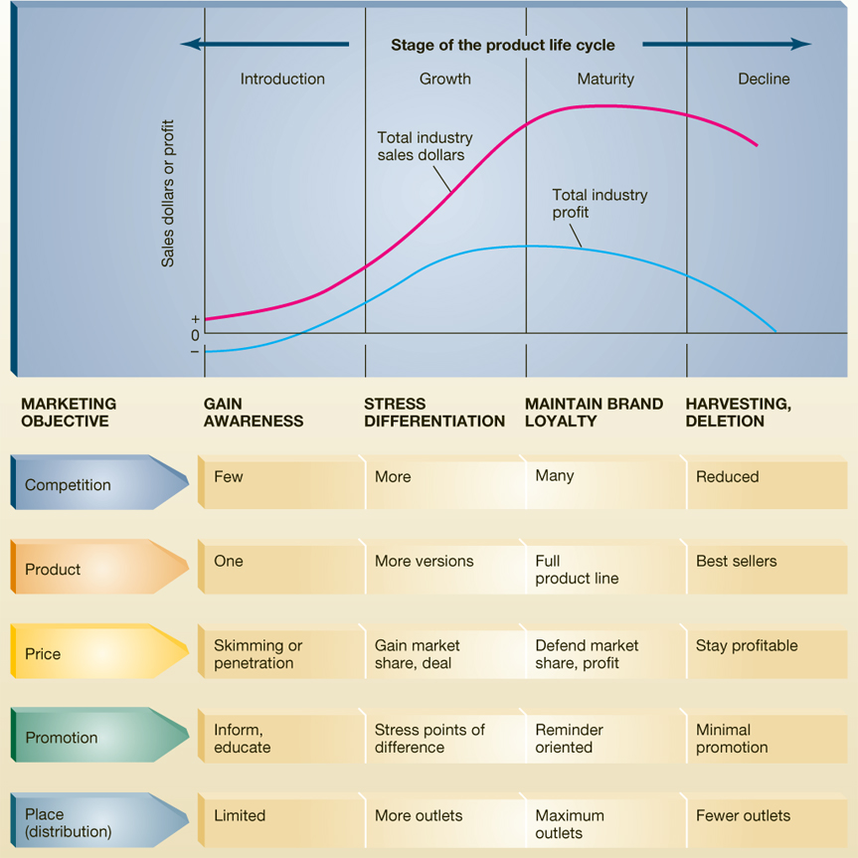
Product Lifecycle
Different stages the product goes through in the marketplace
Introduction
Growth
Maturity
Decline

Slide 6
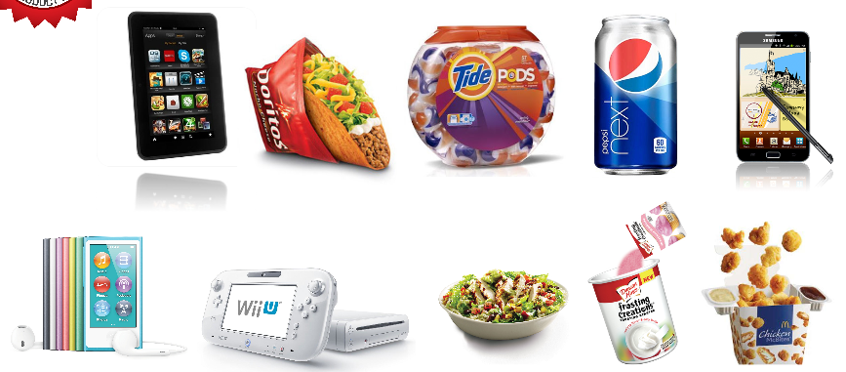
Introduction Stage
Occurs when product is first introduced
Slow sales growth
Profit is minimal
Create Consumer TRIAL

Slide 7
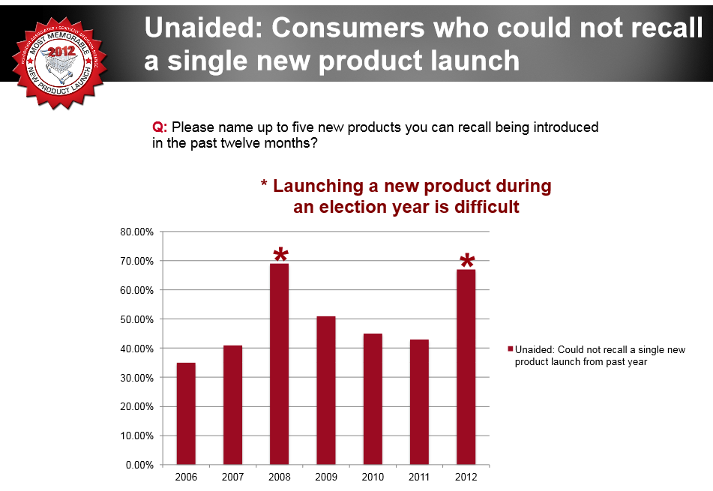
Introducing A New Product is Difficult: Consumers Aren’t Always Paying Attention

Slide 8
Products Launches That People Remembered 2012
Amazon’s Kindle Fire - 30% remember the launch
How Did They Launch the Most Memorable New Product of 2012?
Taco Bell’s Doritos Locos Taco (18.8%) – biggest success for brand
sold 100 million Doritos Locos Tacos in about 10 weeks
Tide Pods (15.6%),
Pepsi Next (13%)
Samsung Galaxy Note (11.7%)
the all-new iPod Nano (10.6%)
Nintendo’s Wii U (8.2%)
Taco Bell Cantina Bowl (7.1%)
Duncan Hines Frosting Creations (5.7%)
McDonald’s Chicken McBites (4.9%).

Slide 9
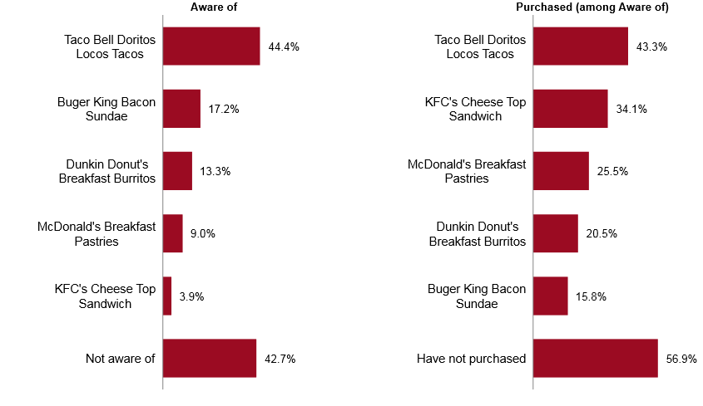
In Fast Food: Taco Bell Doritos Locos Tacos is the clear new product launch winner, dominating both awareness and conversion

Slide 10
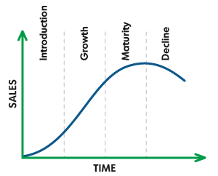
Product Life Cycle Curve

Slide 11
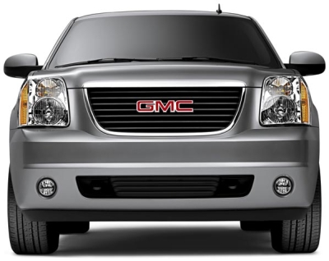
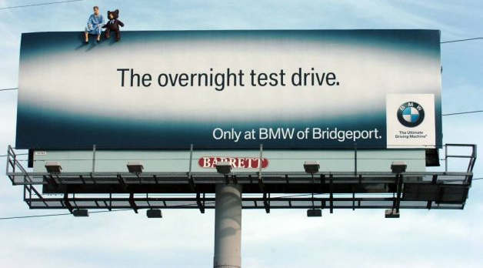
The Overnight Test Drive
House Hunt
consideration of GM products is 50% higher once a customer takes home a vehicle for a test drive
Notes:
What happens when you have a 24 hour trial? Who has ever gotten a free-trial and then can’t give up the product?

Slide 12
Product Life Cycle Curve

Slide 13
Growth Stage
Rapid increases in sales
Competitors appear
More aggressive pricing → profit usually peaks
Product sales grow as a result of people using the product and repeat users
Increase distribution
If the brand can’t generate repeat purchase → brand death

Slide 14
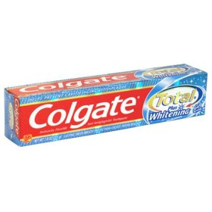
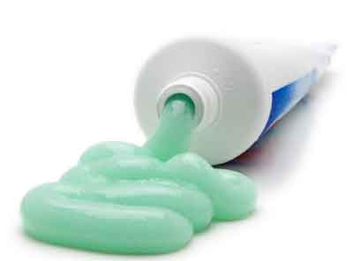
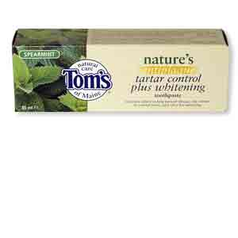

During the Growth Stage
Oftentimes brands differentiate their brands during this time in order to separate from competition
Offer different benefits

Slide 15
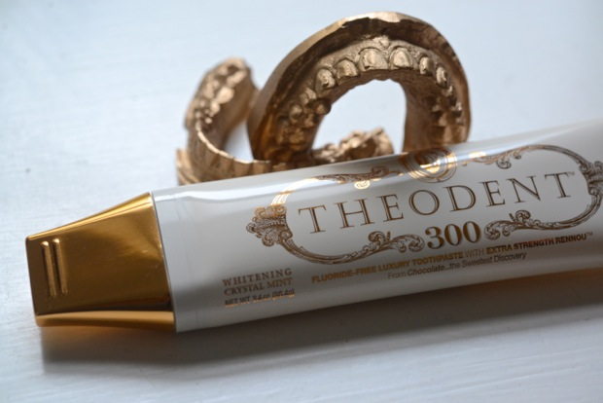
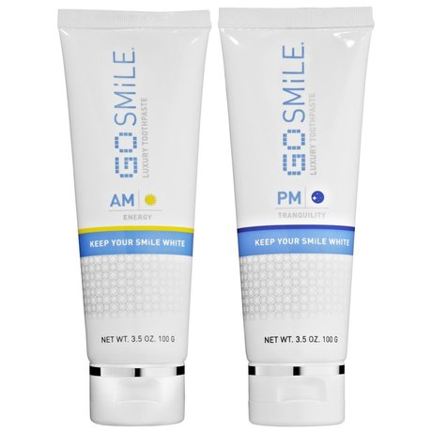
New Toothpaste – 2012 (Luxury)
Theodent regrows your tooth enamel
$9.99
Contain hydrated silica to polish away surface stains and fluoride to fight cavities and strengthen enamel
$39.00

Slide 16
Product Life Cycle Curve

Slide 17
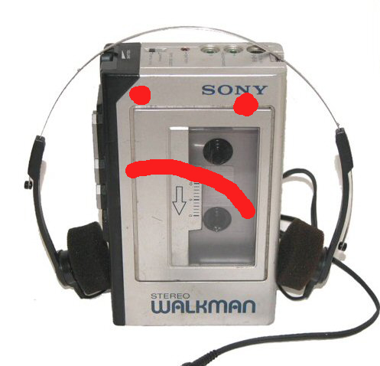
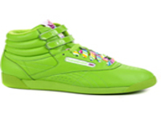
Maturity Stage
Slowing of total industry sales
Marginal competitors exit the market
Most consumers have tried (and abandoned the product)
Profit declines

Slide 18
Product Life Cycle Curve

Slide 19
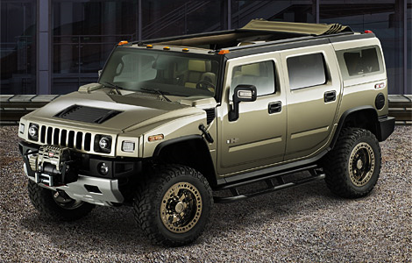
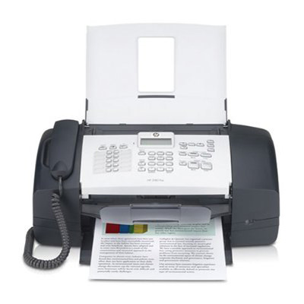
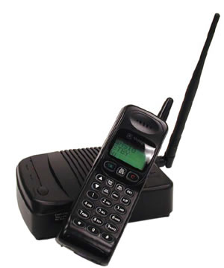
Decline Stage
Sales and profits decline
Often occurs due to environmental factors

Slide 20
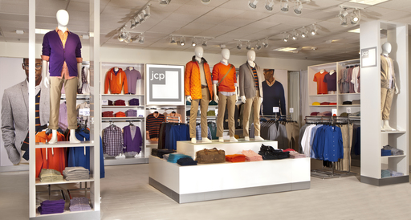
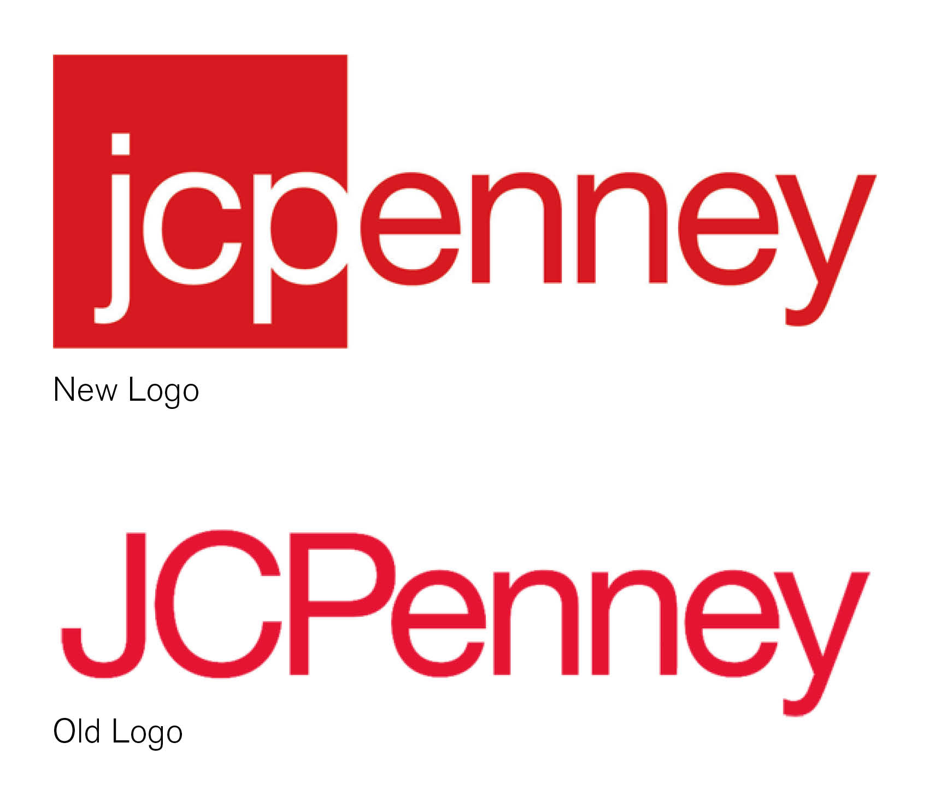
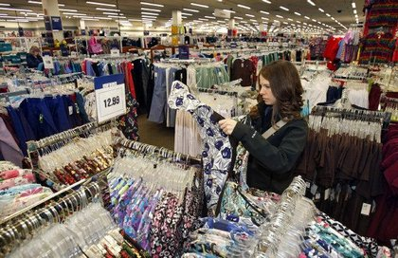
JCPenney
What did JCP do to deal with their decline?
Changing Brand

Slide 21
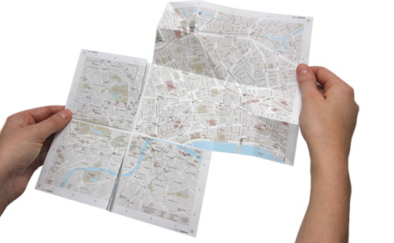

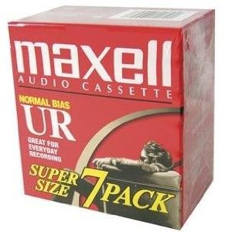
Deletion and Harvest
Product Deletion
Drop the product from the product line
Harvesting
Company retains the product but reduces the costs of marketing
Less worthy segment
Stationary

Slide 22
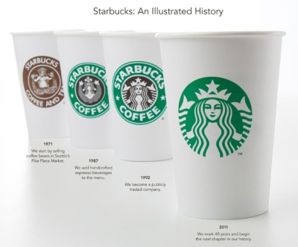
Starbucks
Where is Starbucks in the Product Life Cycle?
How is the company dealing with the changes?

Slide 23
Dimensions of Product Life Cycle
Length
Shape of sales curve
How they vary with different level of product
Rate at which consumers adopt product

Slide 24
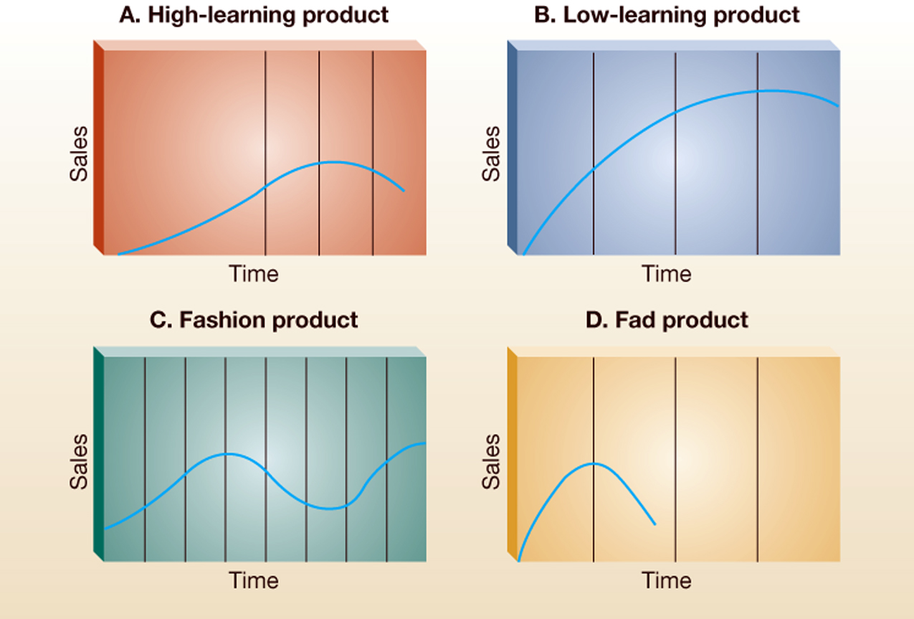
PLC for different product types

Slide 25
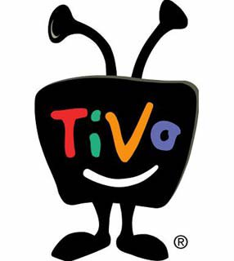
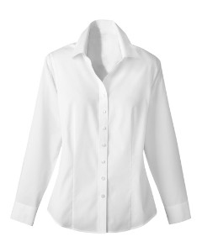
High VS. Low Learning Product

Slide 26
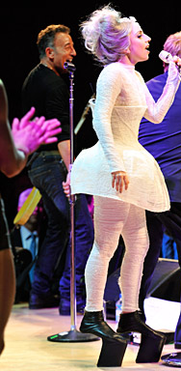
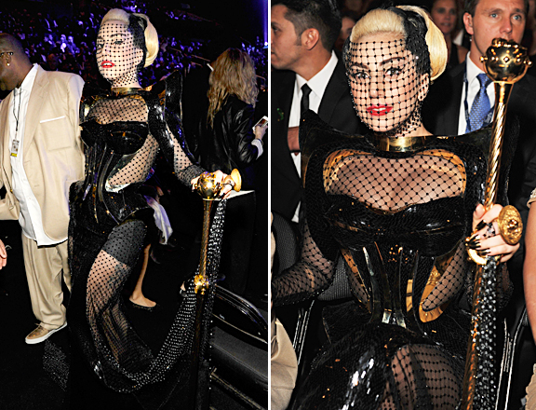
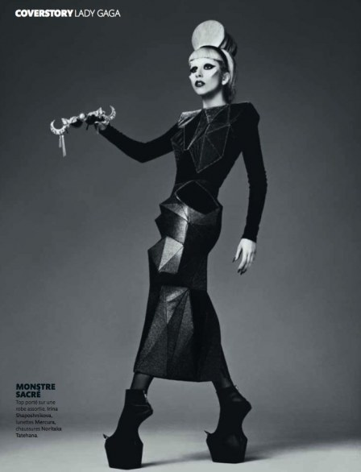
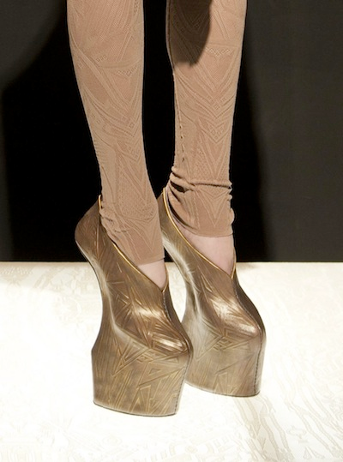
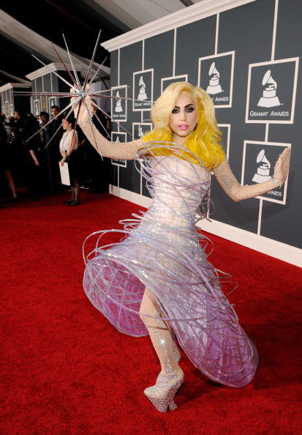
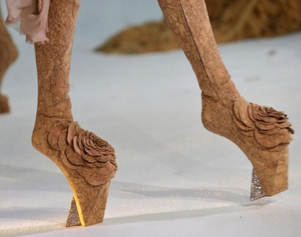
Fashion Product

Slide 27

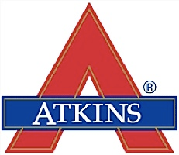
Fad vs. Trend?
Fashion product – long(er) term trend
Fad – rapid incline and subsequent decline in trend
VS.

Slide 28
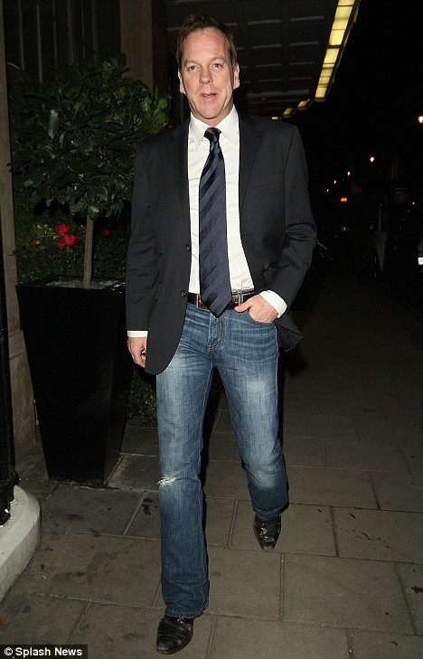

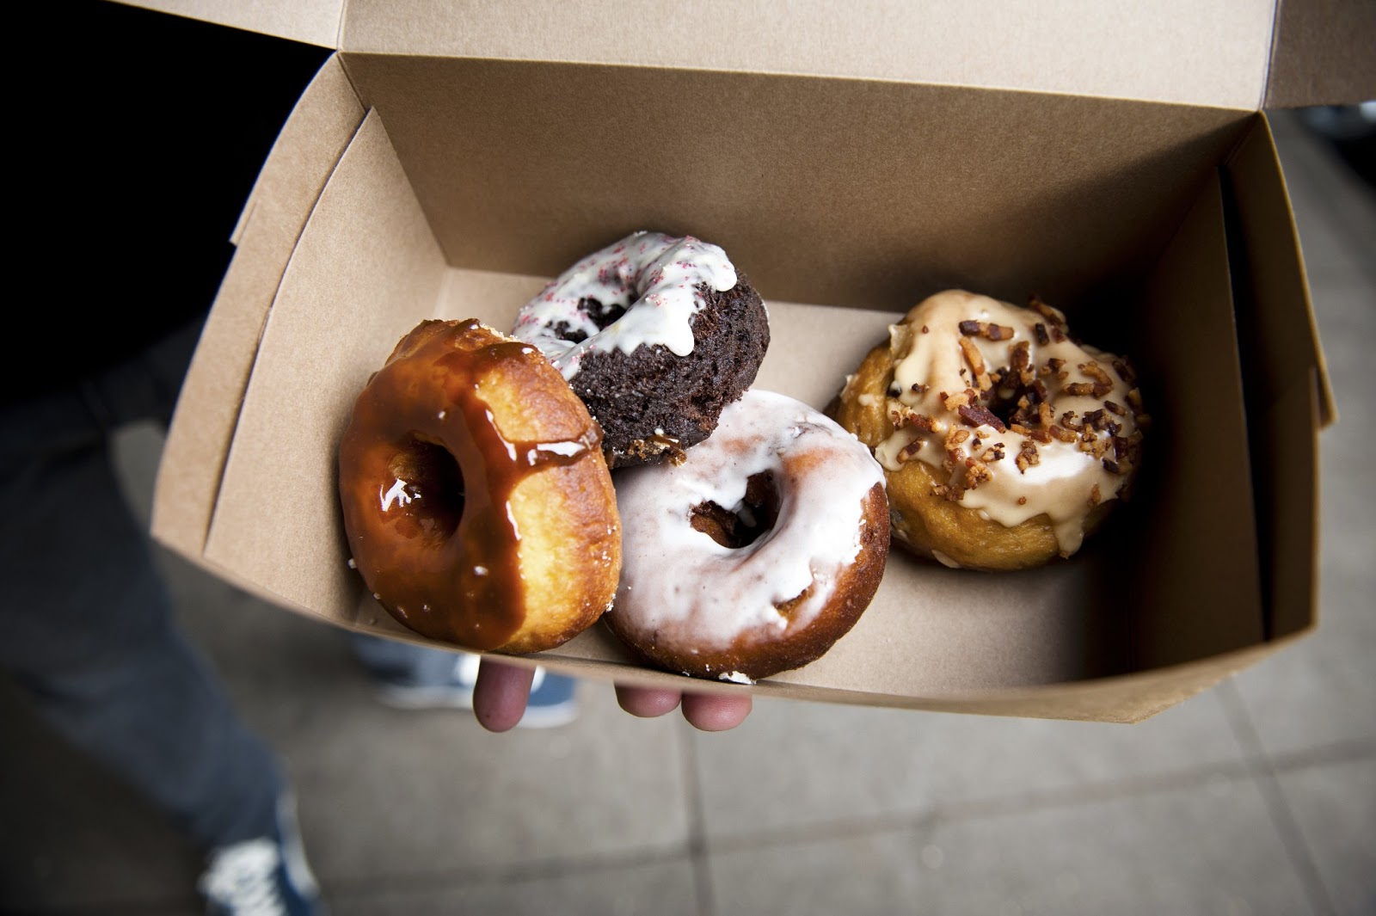
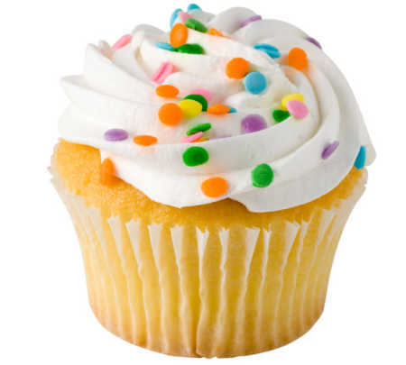
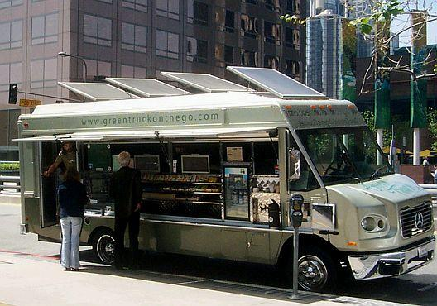

VS.

Slide 29
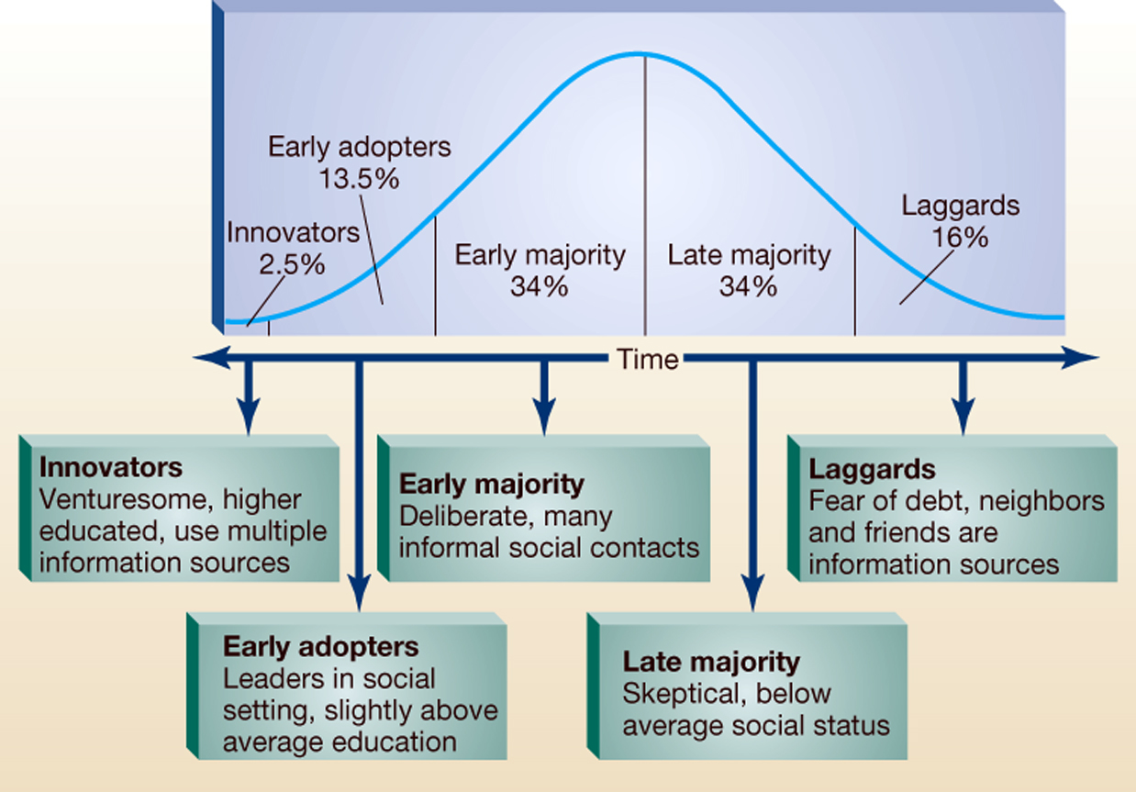
Diffusion of Innovation
Not all buyers purchase in the introductory stage
The product “diffuses” into the population

Slide 30
Factors Affecting Adoption Rate for Innovations
Relative advantage
how much improvement over current option
Compatibility
compatible with existing systems, values, beliefs, ideas
Complexity
how hard is it to use the innovation
Trialability
ability of potential users to try on a limited basis
Observability
degree to which innovation and results are observable by others

Slide 31
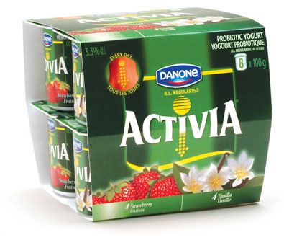
Factors Affecting Product Adoption
Usage Barriers
Existing habits
Value Barriers
No reason to change
Risk Barriers
Physical, economic,
social
Psychological Barriers
Cultural differences or image
Notes:
How many students have tried this new product? Why not – b/c we don’t have the issues that the product caters too –
Also (even if we have the symptoms), we have image barriers

Slide 32
Managing the Product Lifecycle
Role of Product Manager
Manages the marketing efforts of the products or brand in
Modifying the Product
Modifying the Market
Repositioning the Product

Slide 33

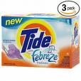

Modifying the Product
Changing the product’s characteristics

Slide 34
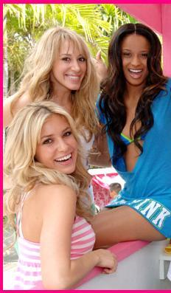
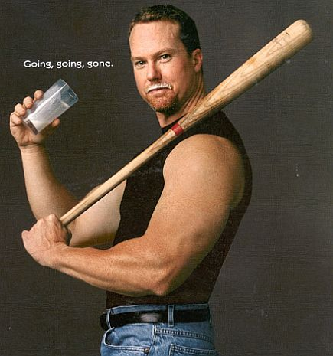
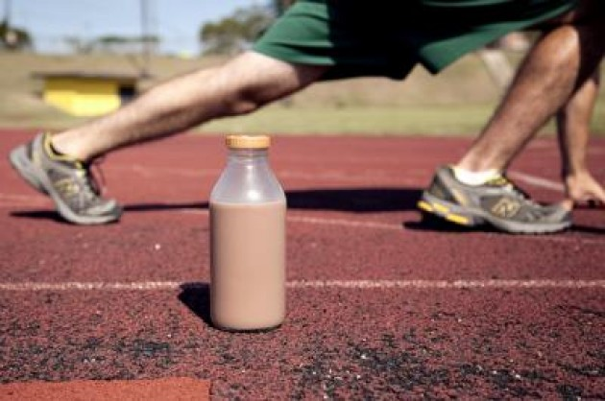
Modifying the Market
Finding new users
E.g., VSC found a new customer
that was introduced to the
brand – younger, lower salary,
Increasing use
Use the product more frequently

Slide 35
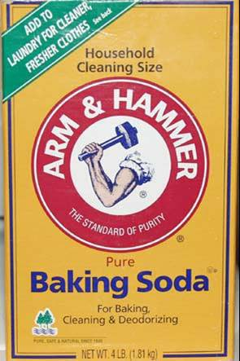
Modifying the Market
Creating New Use Situations
New use for existing product
Repositioning the Product
Change the place a product occupies in consumers’ minds
Reacting to competitor position
A competitor’s add is affecting you
FUBU becomes FB
Mercedes
BMW - Beats the Bends
Notes:
advert by Mercedes about the accident on Chapman’s Peak in South Africa and how the driver survived as he was driving a Mercedes. Then BMW’s counter competitive advertising campaign was about how if you were driving a BMW it would not have happened to start off with.

Slide 36
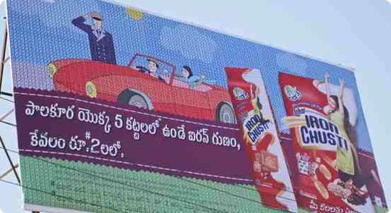

Modifying the Market
PepsiCo India is test-marketing two products: Lehar Gluco Plus, a beverage with electrolytes and glucose, and Lehar Iron Chusti, a fortified iron snack. Both are aimed at consumers at the bottom of the pyramid — in urban (and rural) areas
Reaching a new market
New customer base without
prior experience with brand
Catching a rising trend
(Re)positioning in order to capture a strong market trend
Changing the value offered
Trading up or down
Notes:
At target we splurge and save – trade up for hand soap but trade down with the product

Slide 37



Branding and Brand Management
Branding
When an organization uses signals to articulate itself to customers (e.g. name, phrase, symbol)

Slide 38



Brand Personality & Equity
Brand Personality
Human characteristics associated with the brand
Notes:
What are the “human words” that come to mind when you think about these brands?
Fun, honest, irreverant
Stuffy, snooty, elite

Slide 39
Describe the “Personality” of
TIME Magazine –loves politics, full of ‘fun facts,’ masculine, enjoys debating and bringing up loaded issues to see how people react
ESPN
Dell
Flying Girl
Mac vs PC personality
Whole Foods

Slide 40
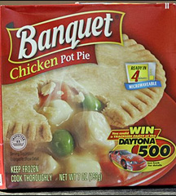
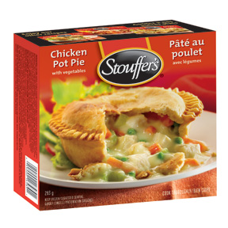
Brand Equity
The added value a brand name gives to a product BEYOND the functional benefits provided
Similar to “goodwill”
Benefits of Brand Equity
Competitive
advantage
Higher $$$
Notes:
Stouffer’s is a name brand with brand equity while Banquet is an HEB private label – which would you pay more for (without even trying the products)

Slide 41
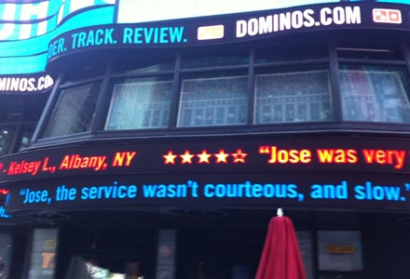
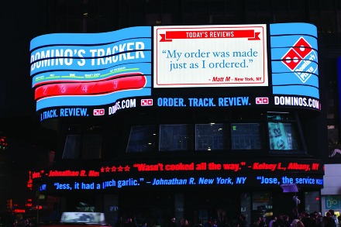
Brand Equity + Brand Personality
While many trends are all about the new, it’s always worth remembering that success in business in the end is about being aligned with consumer culture than just being aware of ‘new’ techniques and technologies.
In July 2011, US based fast food retailer Domino’s launched a month-long promotional campaign in New York. Hiring out a huge billboard space in Times Square, the brand livestreamed (good and bad) customer feedback given via Twitter

Slide 42
Picking a Good Brand name
Product Benefits
Memorable, Distinctive, Positive
Fit the company
No legal restrictions
Simple (possibly emotional)
Which ones of these work? Why or Why not?
Apple - Pantene - Tiguan by Volkswagen
Starbucks - Old Spice - Yatt'it (online travel community)
St. Bernard's Sports - The “W” hotel

Slide 43


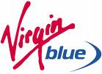


Branding Strategies
Multiproduct Branding
Uses one name for all of its Branding

Slide 44
Multiproduct Branding
Advantages
If customer has 1 positive experience, transfer of positive attitude to other products
Enables line extensions
Disadvantages
Brand confusion
One bad experience can ALSO bleed over to all other brands

Slide 45

Branding Strategies
Multibranding Products
Each product has distinct name
P&G employs this strategy

Slide 46
Multibranding
Advantages
Each brand is unique and no risk that one failure would affect another products
Porducts don’t all have to “work together”
Disadvantages
Company has to generate marketing and consumer recognition of each brand individually

Slide 47

Branding Strategies
Private Branding
Manufacturers sells the brand under the brand name of wholesaler or retailer
Wal-Mart has private labels including:
Great Value
Equate
Sam's Choice
Wal-Mart
Member's Mark (Sam's Club)

Slide 48
Branding Strategies
Mixed branding
The firm markets products under own name and that of the reseller b/c the segment is “attached” to the reseller

Slide 49
Review
What are the stages of the product life cycle?
What are the factors affecting product adoption?
What is brand equity?

